Slide 1
Floyd-Warshall Reinforcement Learning: Learning from Past Experiences to Reach New Goals
Vikas Dhiman, Shurjo Banerjee, Jeffrey M. Siskind, Jason J. Corso
The University of Michigan
Purdue University
(arXiv:1809.09318v4 [cs.LG] 4 Jan 2019)

Slide 2
Outline
Introduction
Related work
Method
Experiments
Conclusion

Slide 3
Introduction

Slide 4
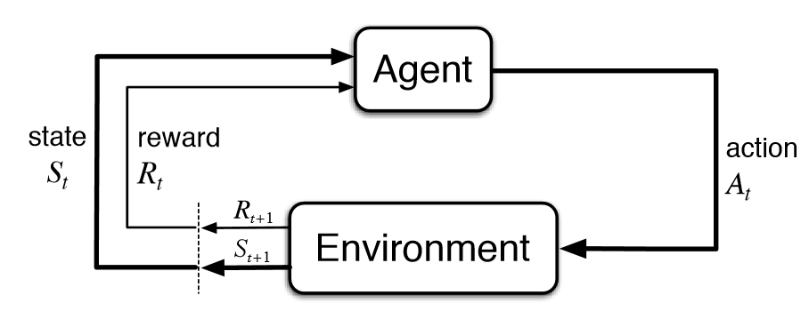
Introduction – Reinforcement Learning
Reinforcement Learning (RL) allows for agents to learn complex behaviors in a multitude of environments while requiring supervision only in the form of reward signals.

Slide 5
Introduction – Problem
Consider multi-goal task that involve static environments and dynamic goals.
There are two types of RL algorithms
Model-free RL cannot transfer learned information when goal location changes, but achieves high asymptotic accuracy.
Model-based RL can transfer learned information to new goal location, but limited by the fact that small errors in modelling.

Slide 6
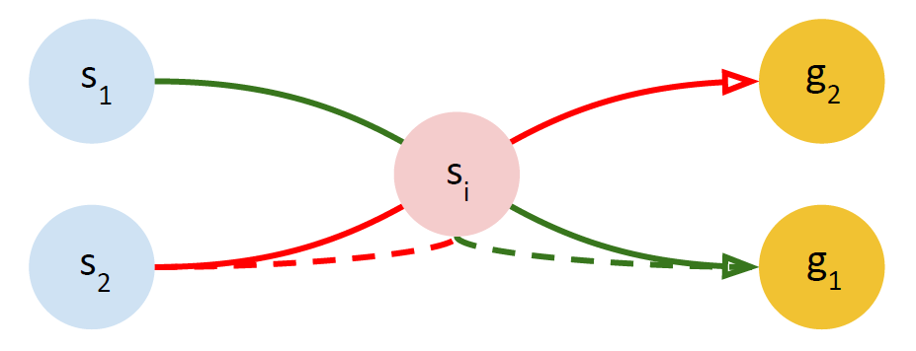
Introduction – Floyd-Warshall Reinforcement Learning
Floyd-Warshall Reinforcement Learning (FWRL)
Improve the limitations of model-free RL in multi-goal domains.
Learns higher reward strategies in multi-goal task than model-based RL.

Slide 7
Related work

Slide 8
Related work – Goal-conditioned value functions
Introduced by (Schaul et al., 2015), universal goal-conditioned value functions (UVFs) measures the utility function of achieving any goal from any state in an environment.
In Hindsight Experience Replay (HER), Andrychowicz et al. (2016) learn UVFs from previous episodes accounting for when the goal location has not been achieved.
Pong et al. (2018) propose Temporal Difference Models (TDM) combines model-based and model-free algorithms by modeling the learning as a constrained objective function using a horizon dependent goal-conditioned value function.
In contrast to all the above works, FWRL is a novel algorithm for learning UVFs via leveraging a triangular-inequality like constraint within the space of these functions.

Slide 9
Background – Dijkstra
Dijkstra (Dijkstra, 1959) is a shortest path finding algorithm from a given vertex in the graph. Consider a weighted graph G = (S, E), with S as the vertices and E as the edges.

Slide 10
Background – Floyd-Warshall
The Floyd-Warshall algorithm (Floyd, 1962) is a shortest path finding algorithm from any vertex to any other vertex in a graph.

Slide 11
Background – Q-Learning
Q-learning (Watkins and Dayan, 1992) is a reinforcement learning (RL) algorithm that allows agent to explore environment and simultaneously compute maximum reward paths.
An RL problem is formalized as an Markov Decision Process (MDP).
The Q-learning algorithm works by updating the Q-function using the Bellman equation.

Slide 12
Markov Decision Process (MDP)
An RL problem is formalized as an Markov Decision Process (MDP).

Slide 13
Bellman Equation
A Bellman equation is a necessary condition for optimality associated with the mathematical optimization method known as dynamic programming.
It writes the "value" of a decision problem at a certain point in time in terms of the payoff from some initial choices and the "value" of the remaining decision problem that results from those initial choices.

Slide 14
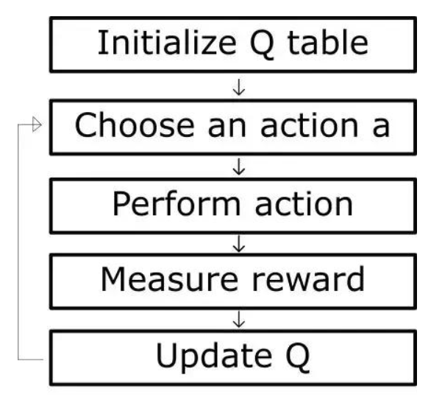
Background – Q-Learning
Q-learning works by maintaining an action-value function Q：$S×A$ , which is defined as the expected return from a given state-action pair.

Slide 15
Method

Slide 16
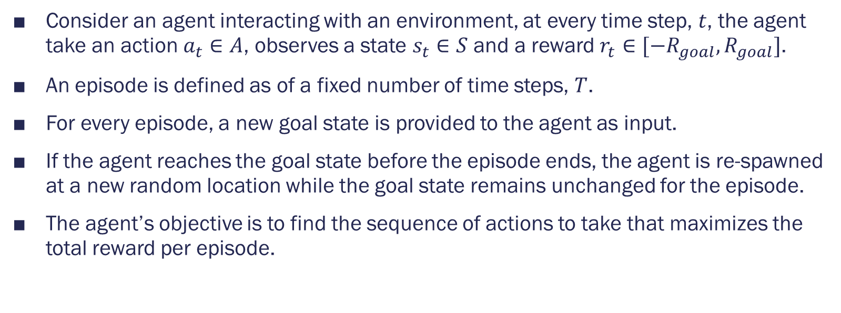
Problem Definition
Consider an agent interacting with an environment, at every time step, $t$, the agent take an action $a_{t}∈A$, observes a state $s_{t}∈S$ and a reward $r_{t}∈[−R_{goal}, R_{goal}]$.
An episode is defined as of a fixed number of time steps, $T$.
For every episode, a new goal state is provided to the agent as input.
If the agent reaches the goal state before the episode ends, the agent is re-spawned at a new random location while the goal state remains unchanged for the episode.
The agent’s objective is to find the sequence of actions to take that maximizes the total reward per episode.

Slide 17
Method – Floyd-Warshall (FW) function
We define the Floyd-Warshall (FW) function as the expected cumulative reward on going from a start state to an end state within an episode.

Slide 18
Method – Floyd-Warshall (FW) function
We define the optimal FW-function as the maximum expected value that a path between a start state and a goal state.
The optimal policy can be computed from FW-function similar to the Q-learning algorithm.

Slide 19
Method – Floyd-Warshall (FW) function
When the policy is optimal, the Floyd-Warshall function must satisfy the constraint.

Slide 20
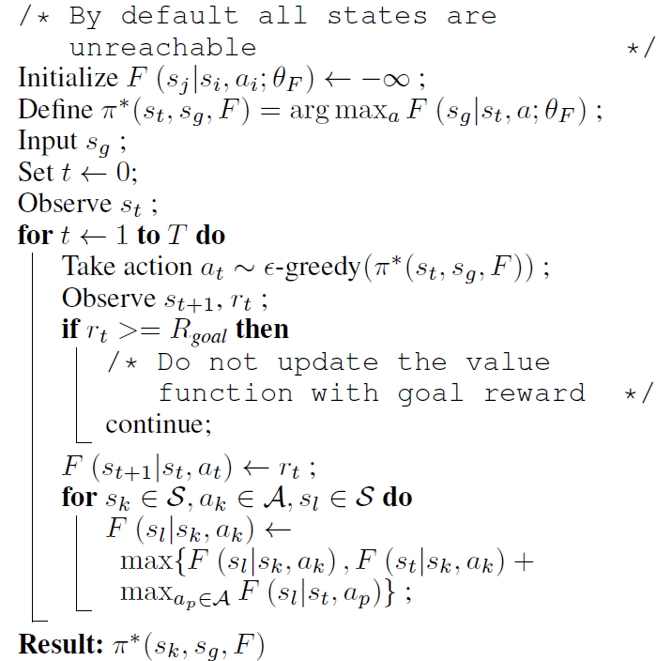
Method – The pseudo code for FWRL

Slide 21
Experiments

Slide 22
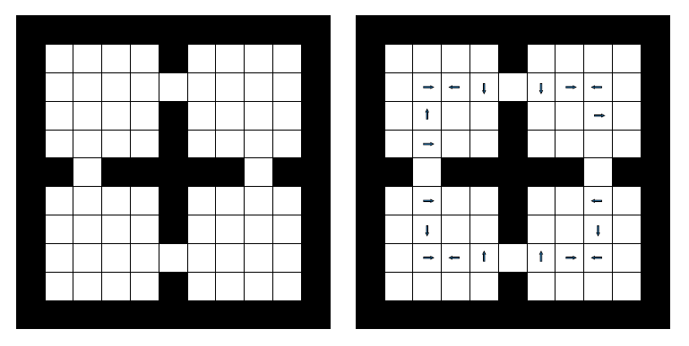
Experiments – Four room grid world
The agent can occupy any one of the white blank squares.
Agents can act by moving in four directions {up, down, left, right} to reach the goal.
The wind, indicated by arrows, increases the probability of the agent randomly going in the direction of the arrow by 0.25.

Slide 23
Metrics
Reward: The reward earned per episode by the agent.
Distance-Inefficiency: The ratio of the distances travelled by the agent during an episode to the sum of the shortest path to the goal at every point of initialization.

Slide 24
Baselines
QL: This version of Q-Learning does not use the prior knowledge of the goal state, but depends upon the goal reward to build a new Q-function in every episode.
QLCAT: We concatenate the state with the goal location and retain the learned Q-function function across episodes.
Model-based RL: We implement a simple version of tabular model-based RL where we maintain a transition count data-structure T(s’|s, a).

Slide 25
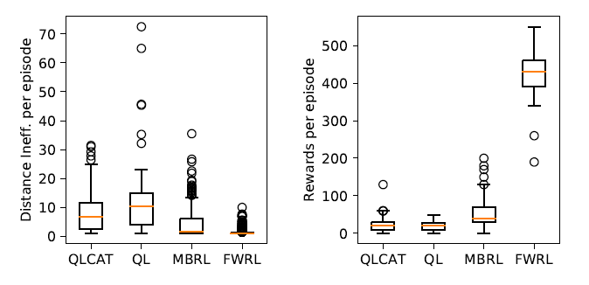
Results on grid world
Left: Distance-Inefficiency (Lower is better)
Right: Reward (Higher is better)

Slide 26
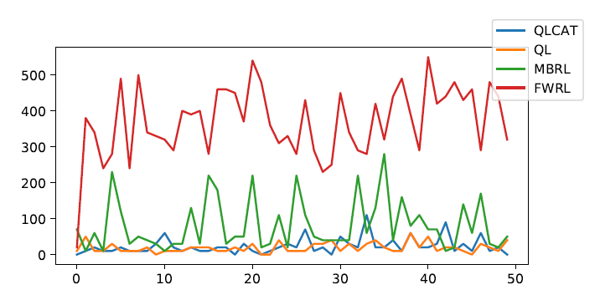
Reward curves on windy world

Slide 27
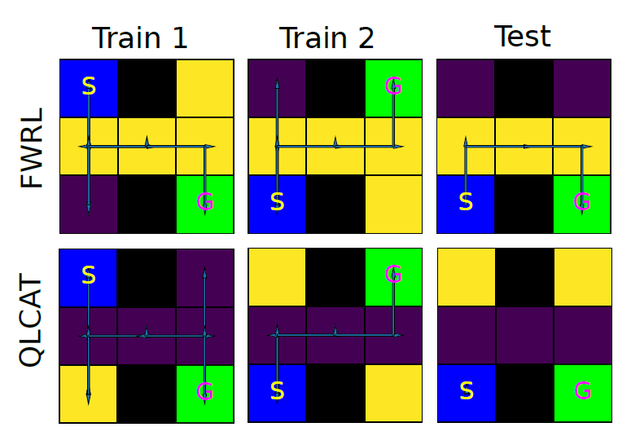
Qualitative results: Visualization of value-function in H-Maze

Slide 28
Conclusion

Slide 29
Conclusion
FWRL allows us to learn a goal conditioned action-value function which is invariant to the change in goal location as compared to the typical Q-learning.
Many goal conditioned tasks like navigation and robotic pick and place can benefit from this framework.

Slide 30
End
Thank you for listening

